Slide 1


Relationships, Sexual Health and Parenthood (RSHP) education
Family learning event March 2021

Slide 2

Relationships, Sexual Health and Parenthood (RSHP) education
RSHP education is part of our Health and Wellbeing curriculum.
Our school now uses a new national resource that you can see at https://rshp.scot/
Our RSHP curriculum has been in place for some years; it is part of Curriculum for Excellence. This new resource is designed to help us to deliver the existing RSHP curriculum.
A national teaching and learning resource for Relationships, Sexual Health and Parenthood (RSHP) education
https://rshp.scot

Slide 3
What is RSHP?
“RSHP education is a key part of Health and Wellbeing within Curriculum for Excellence. RSHP education focuses on equipping children and young people with the knowledge, skills and values to make informed and positive choices about forming relationships. It can assist with making safer decisions about their sexual and emotional health and wellbeing in a responsible and healthy manner, as an important part of preparation for adult life.”
Conduct of Relationships, Sexual Health and Parenthood Education in Schools; Scottish Government, 2014

Slide 4
What is the RSHP resource?
A teacher or early years practitioner can use the resource to support teaching and learning.
All content is age and stage appropriate for learners 3-18 years, organised by Curriculum for Excellence Levels, from Early Level through to Senior Phase.
Content is up-to-date and engaging and meets the needs of all learners, including those with additional support needs.

Slide 5
What content is delivered within RHSP?
- Physical changes
- Sexual health and sexuality
- Role of parent/carer
- Positive relationships
7 themes
- Bodily autonomy, consent and protection from harm
- Emotional wellbeing and help-seeking behaviour
- Equalities and inclusion
- Gender equality, discrimination and gender-based violence
- Parenthood and families
- Relationships and friendships
- Sexual health and reproduction

Slide 6
Second Level (P5 to P7)
Names of parts of my body
My body is changing (inc menstruation)
Feelings and puberty
Personal hygiene
What is a friend?
Making and Keeping Friends
Online-Offline Friends
A fair and equal life for girls and boys
Stereotypes and Equality
Being Fair
Being transgender
My senses
What is consent?
My body is mine
Where do we go online?
Being smart online
When I feel safe / Feel unsafe
My 5 trusted individuals
Bullying
Physical Abuse and Neglect
Sexual abuse
First Level
Names of parts of my body
My body belongs to me
My friends/Being a friend
Kindness and Empathy
When friends fall out
Looking after plants and animals
Learning about life cycles
Looking after pets
People who help and look after me
People who are special to me
When I have a question or worry
Professional People
My family/All our families are different
This is how I feel
Feeling safe
Similarity, diversity and respect
I am unique: My self portrait
We are similar and different
Boys and Girls
Disability
Heterosexual/LGB
Keeping clean
Safe and happy online
How human life begins, pregnancy and birth
How human life begins, pregnancy and birth What babies need
Early Level Nursery to P1
My Body
My Body Belongs to Me
Unique, Similar and Different
Our Families
People Who Help and Look After Me
Asking Questions, Making Choices
Saying Yes/Saying No
Friends and Friendship: Helping Others
Playing Together, Being Kind
Personal Space and Privacy
When I Feel Sad or Upset)
Looking After Plants and Animals
Pregnancy and Looking After a Baby
First Level (P2 to P4)
Names of parts of my body
My body belongs to me
My friends/Being a friend
Kindness and Empathy
When friends fall out
Looking after plants
Learning about life cycles
Looking after pets
People who help and look after me
People who are special to me
When I have a question or worry
Professional People
My family/All our families are different
Feelings and safety
This is how I feel
Feeling safe
Similarity, diversity and respect
I am unique: My self portrait
We are similar and different
Boys and Girls
Disability
Heterosexual/LGB
Keeping clean
Safe and happy online
How human life begins, pregnancy and birth
What babies need

Slide 7
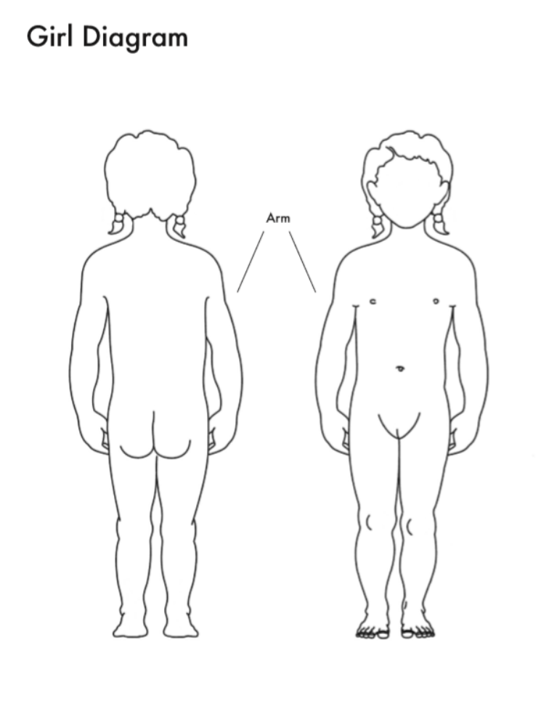
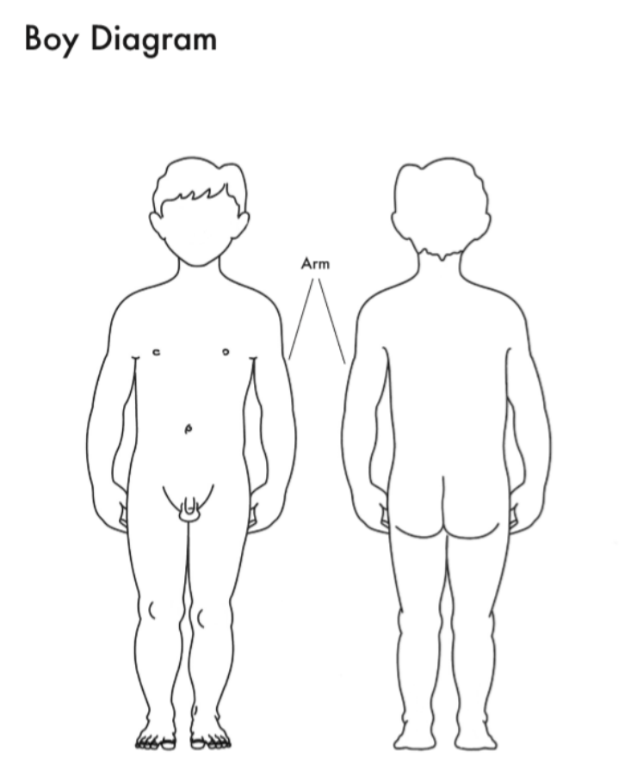
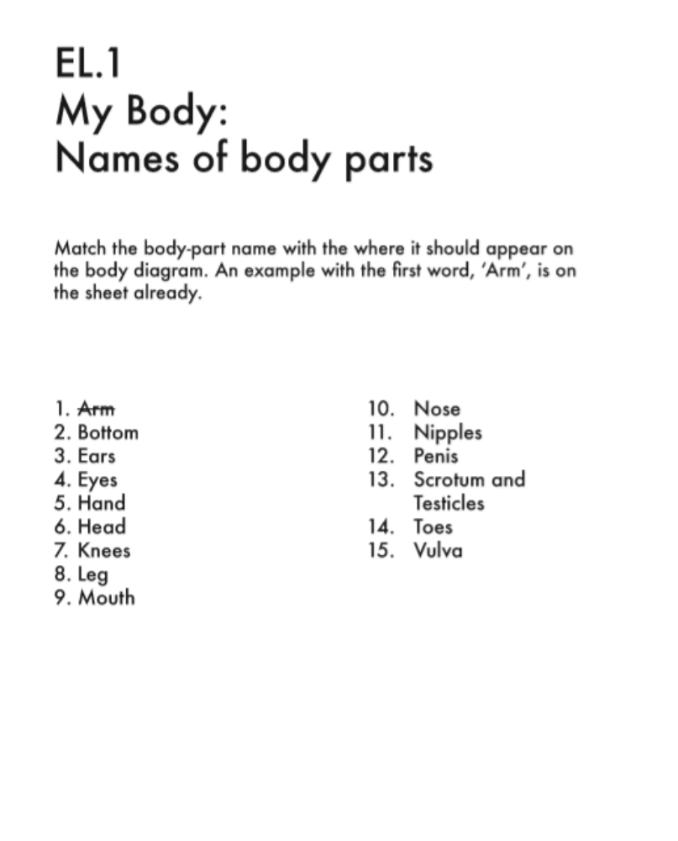
Examples of teaching resources: Early Level

Slide 8
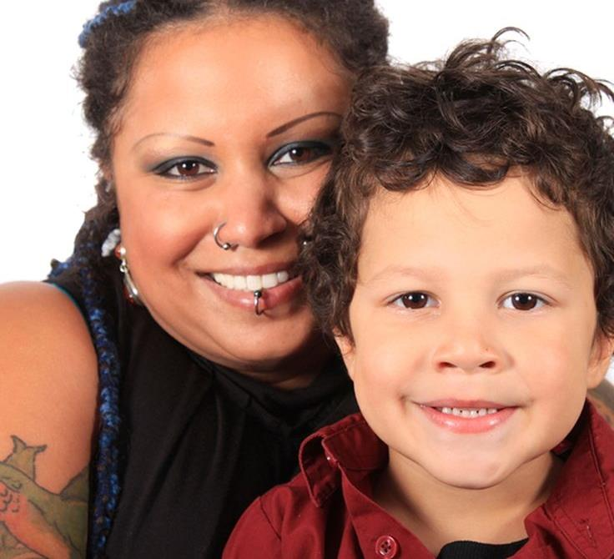
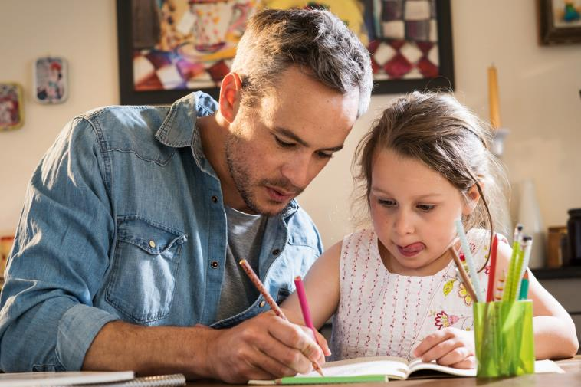
Some families are small.

Slide 9
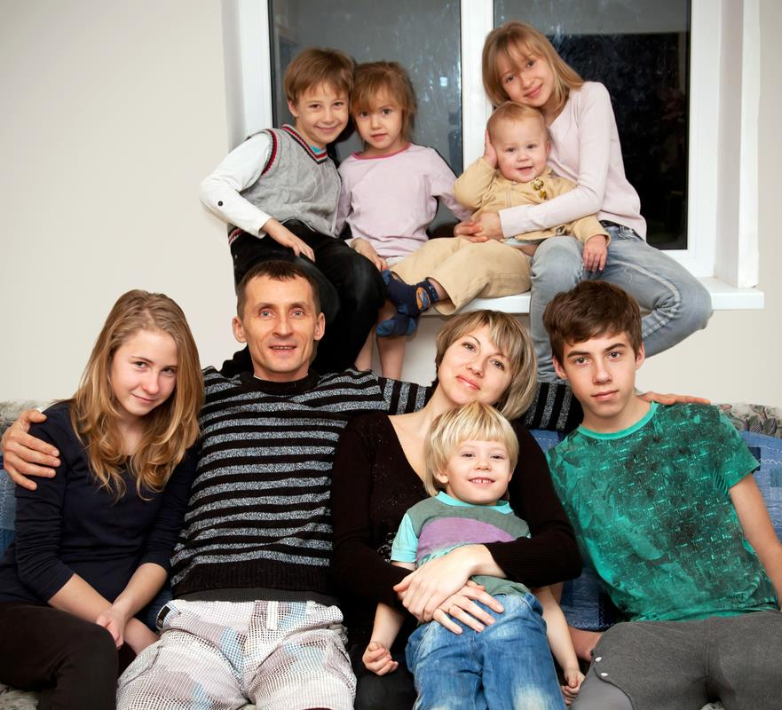
Some families are big.

Slide 10
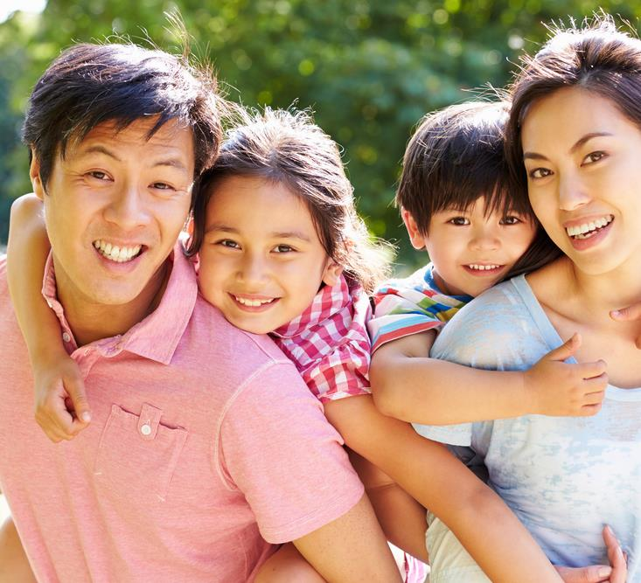
Some families have a dad and a mum

Slide 11
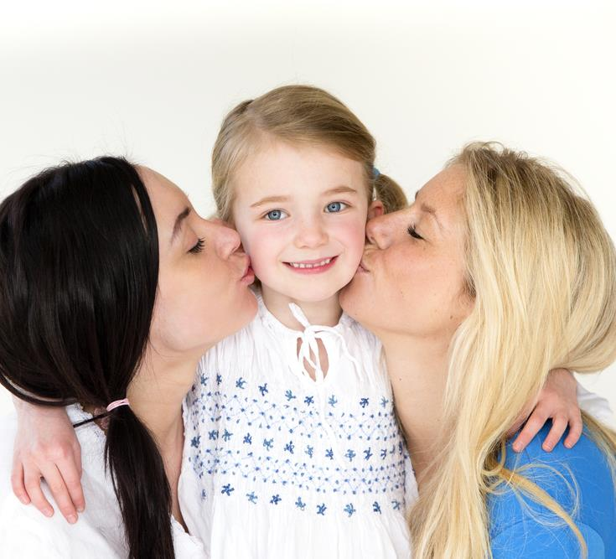
Some families have 2 mums.

Slide 12
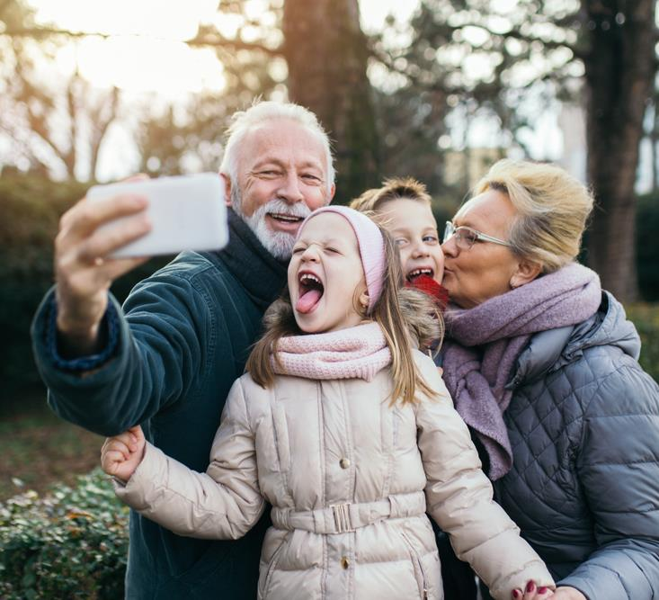
In some families children live with their grandparents.

Slide 13
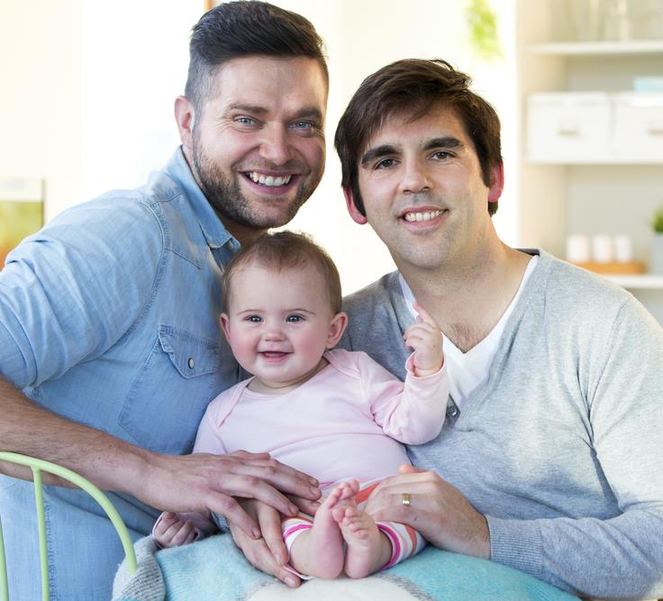
Some families have 2 dads.

Slide 14
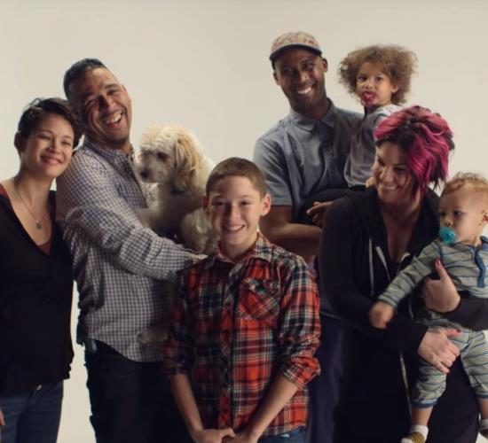
Some families have two mums and two dads.

Slide 15
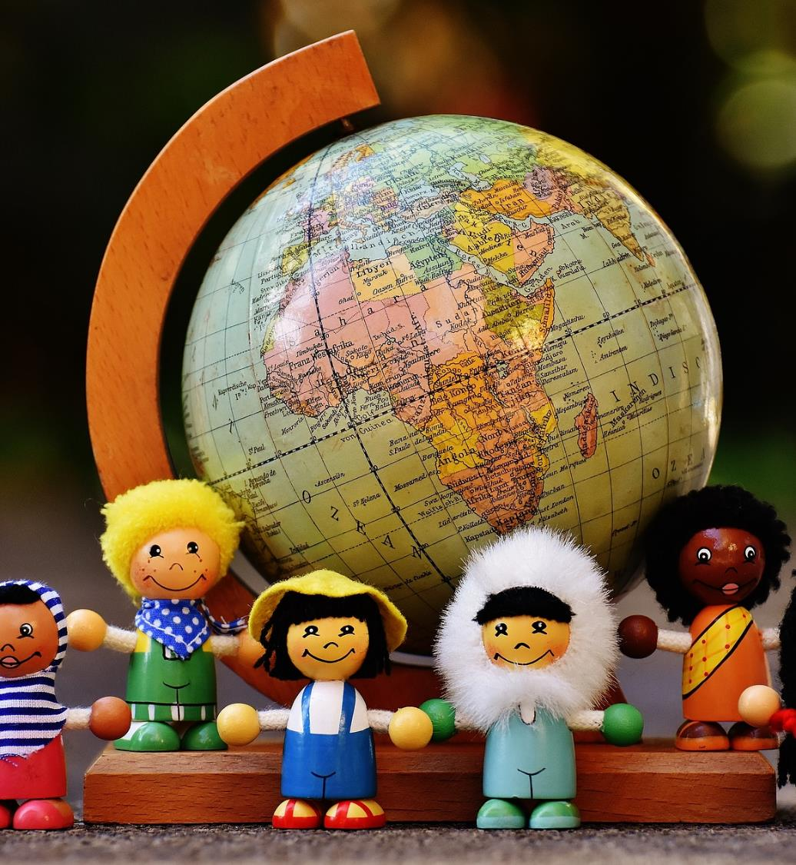
In this class, all our families are different, unique and special.

Slide 16
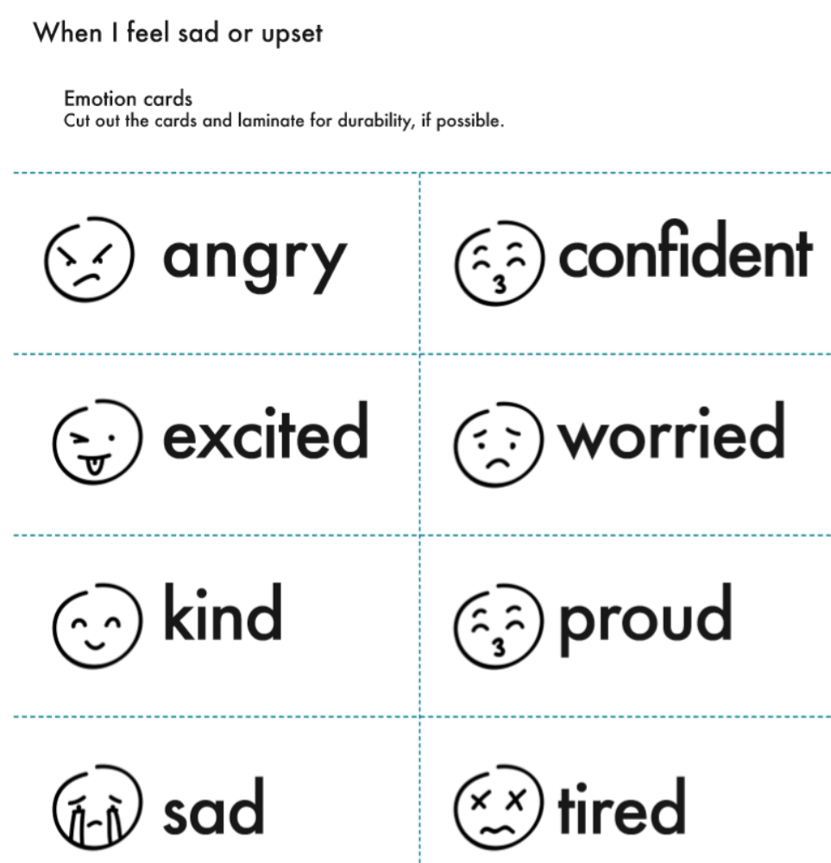
Examples of teaching resources: Early Level

Slide 17
Examples of teaching resources: First Level

Slide 18
My body belongs to me
Examples of teaching resources: First Level
I can talk about what I like about me and my body.
I can explain that my body belongs to me.
I can say who I would go to if I have a question or worry.

Slide 19
How do I communicate with my body?

Slide 20

How do you say YES?

Slide 21

How do you say NO?

Slide 22

How do you say goodbye?

Slide 23

How do you say hello?

Slide 24
How do you say:
‘I like that’!

Slide 25
How do you say:
‘I don’t like that’?

Slide 26

Being positive about your body
You are an individual.
You are you!
You have the right to feel comfortable in your body and about the way you look.
You can feel good about the things your body can do.
You can do your best to take care of your body.
Be kind to others – and you will get kindness back.

Slide 27

I’m Glad I’m Me
By Jack Prelutsky
I’m glad I’m me, I’m glad I’m me
There’s no one else I want to be.
I’m happy I’m the person who
Can do the things that I can do.
If I were someone else, then I
Would feel so strange, I’d wonder, ‘why?’
I’m positive that I’d be sad –
But I am me and I am glad.

Slide 28

In this class, we are all individuals, different, unique and special.

Slide 29
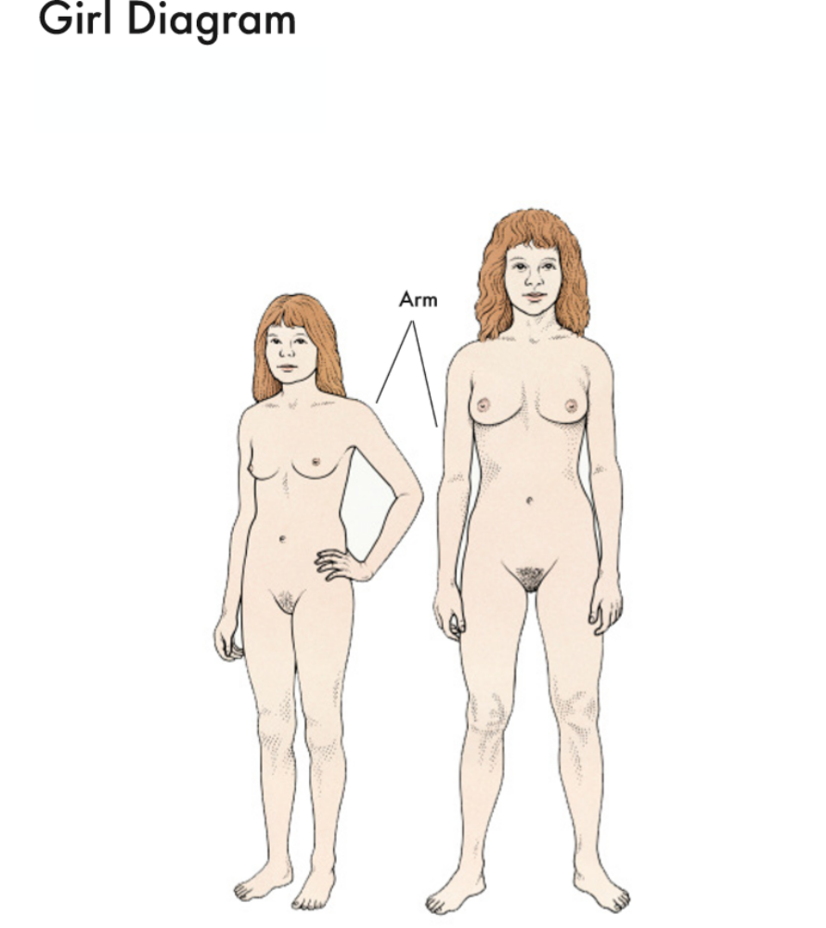
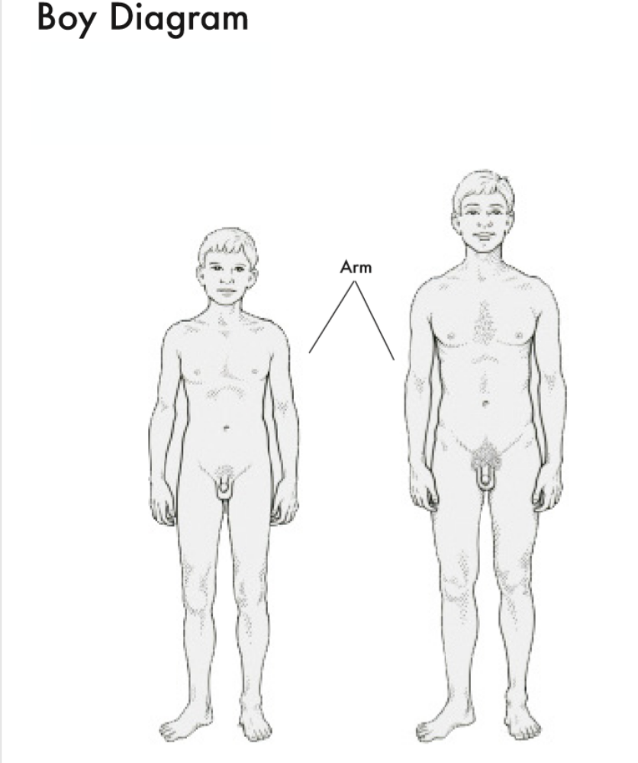
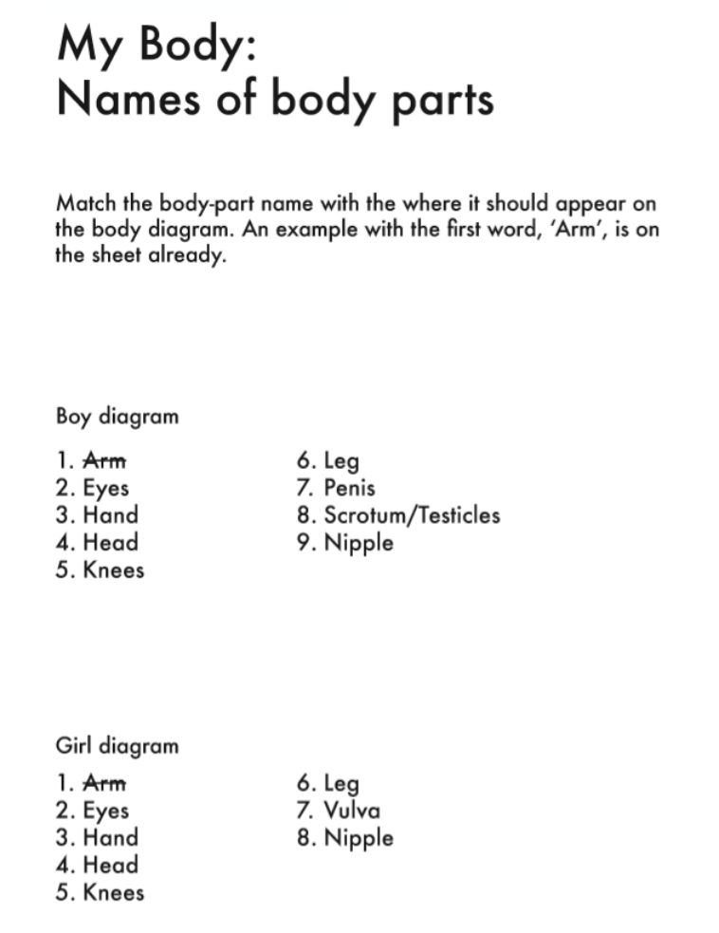
Examples of teaching resources: Second Level

Slide 30
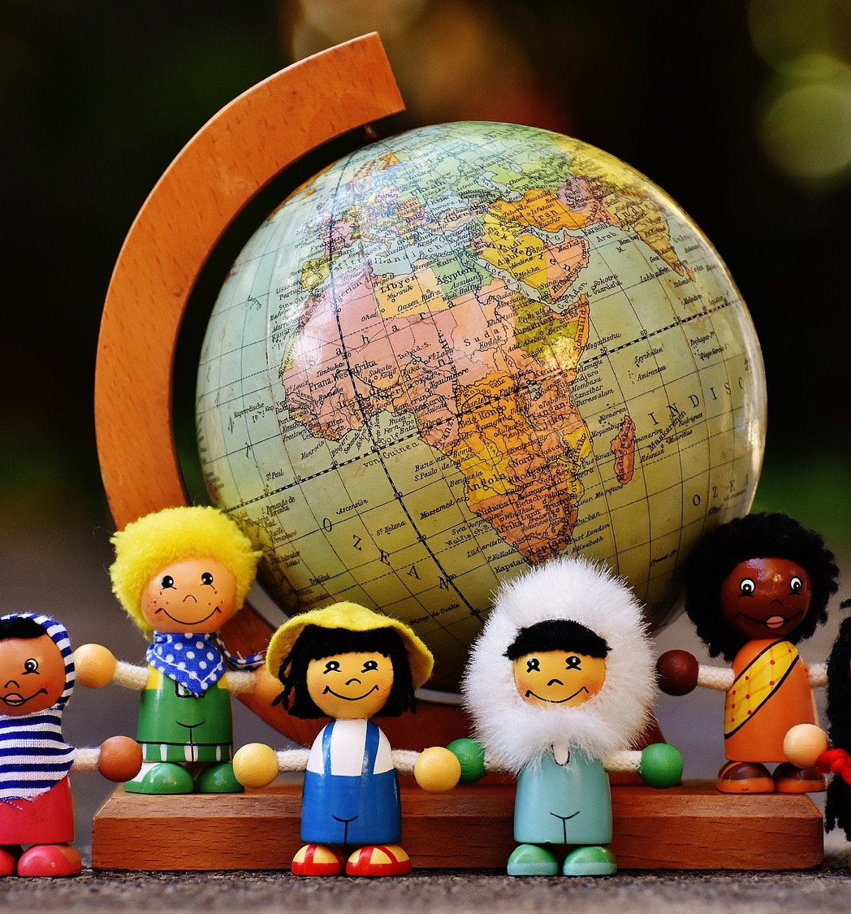
What is a friend?
A friend is a person who knows you well and that you like a lot. A friend is someone you can trust and will treat you well. You can be friendly with many people, but a friend is a special person to you.

Slide 31
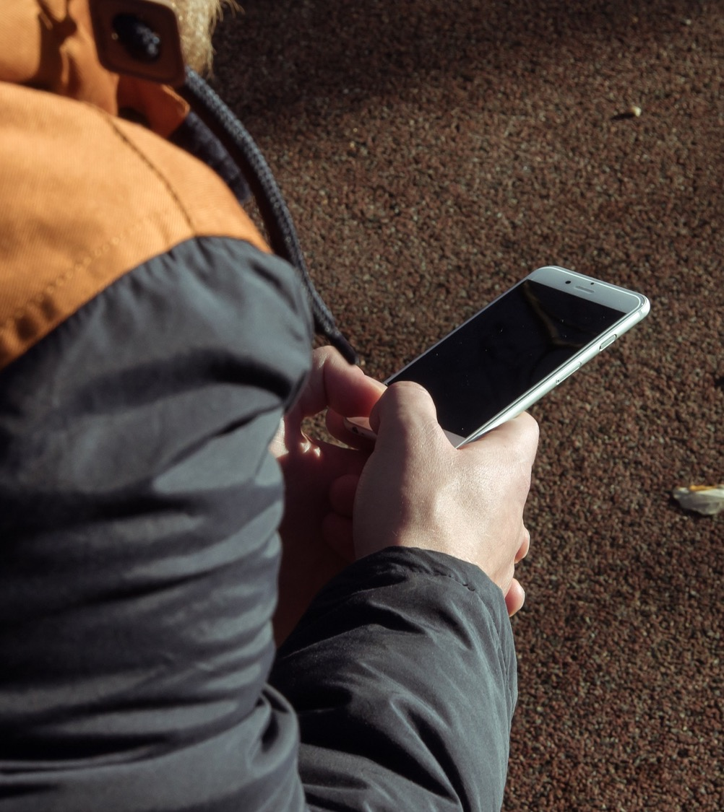
Does a friend have to be someone you can see in real life?
Can a friend be someone you only know online?

Slide 32
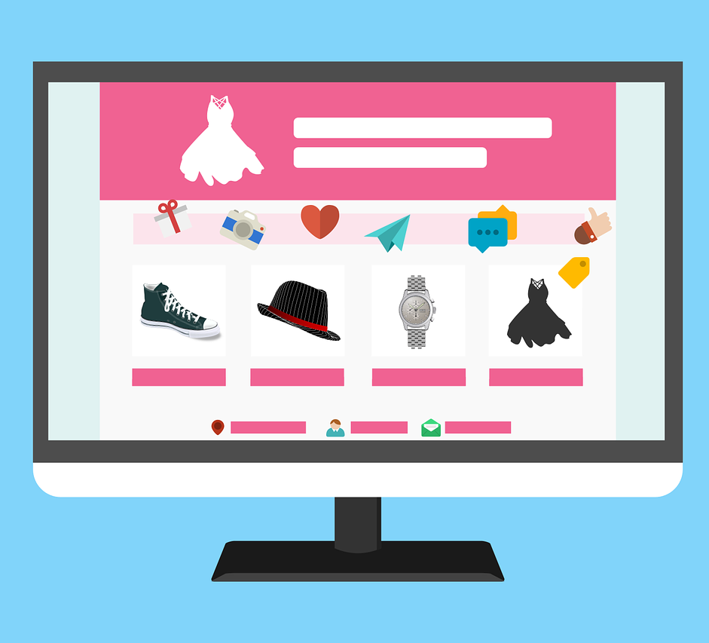
What do we do online?

Slide 33
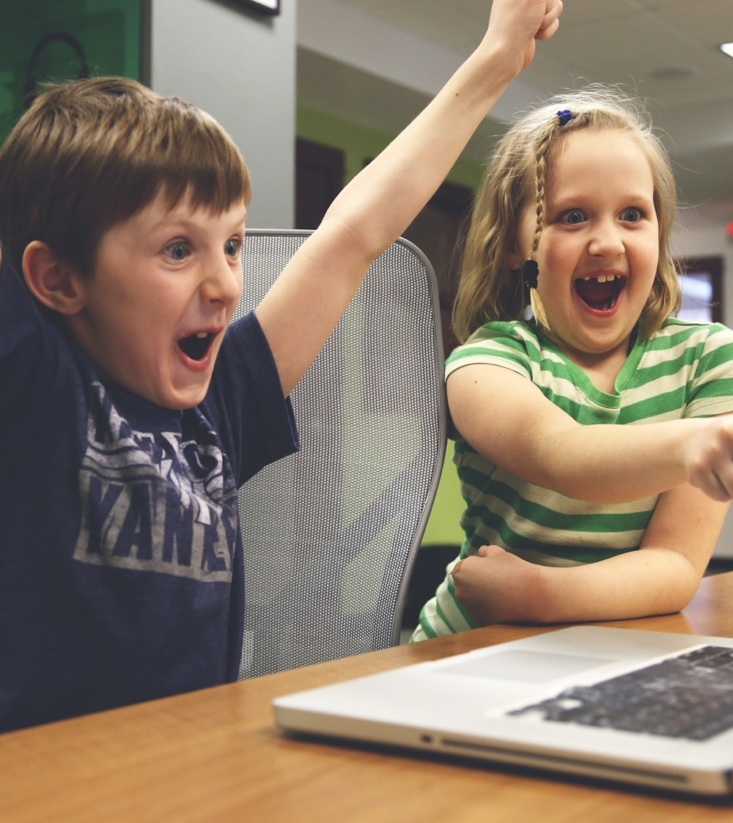
We can have online friendships by:
Chatting online
Using apps
Creating and sharing things
Using Instant Messenger (IM)
In chatrooms and online forums
Gaming

Slide 34

I have just started at a new school and I don’t really know anybody, apart from my big cousin who is in the class above me. I’m quite shy and I don’t find it easy to make new friends. What can I do?
From Katie, P5

Slide 35
I don’t like how some of my friends are behaving. They have been picking on this boy that comes to the football club after school. They call him names, make fun of him because he doesn’t have the same boots. I’m worried if I say something then they’ll stop speaking to me. What can I do?
From Sean, P7

Slide 36
I’ve been playing Minecraft for ages, I’m really good. This other player was okay at first, I’m not sure where he is from but he’s like my friend online, but now he’s saying stuff that I don’t like. If I tell my mum, she won’t understand, or she’ll just ban me from playing. What can I do?
From Raymond, P6

Slide 37
Parent support:
https://rshp.scot to view the materials and parent guides
View videos on Why does RSHP matter? https://vimeo.com/361263347
  Is the resource age and stage appropriate?
  https://vimeo.com/361994410
  and What do children and young people want from their RSHP education?
  https://vimeo.com/361997291
School policy on school website
School leadership team for advice

Slide 38
FAQs
Q: Is it compulsory?
A: The UN Committee on the Rights of the Child has emphasised that states must “ensure that children have the ability to acquire the knowledge and skills to protect themselves and others as they begin to express their sexuality.”
“In the instance of a parent wishing to withdraw a school aged child from sexual health education lessons, schools must remind parents of the child’s right to an education and to participate, bearing in mind their age and maturity. Where, after due consideration…the parent or carer decides to withdraw a school aged child from sexual health education lessons, arrangements should be made for the child to have alternative positive educational provision, which meets the Health and Wellbeing outcomes.”
Conduct of Relationships, Sexual Health and Parenthood Education in Schools; Scottish Government, 2014

Slide 39
FAQs
Q: Can I opt in and out of parts of the programme?
A: No. The programme is delivered in a way which makes this unmanageable. You either opt in or opt out of the whole programme. Be aware that there is continual discussion in all classrooms of aspects of RSHP e.g. positive friendships, people who help us.
Q: Will my child hear about this from other children?
A: Yes. We always ask children to respect the wishes of families who have opted out and to treat this with understanding. Invariably, children ask questions of each other.

Slide 40
FAQs
Q: What happens if my child is upset or anxious?
A: We are trained to manage children’s anxiety in a supportive way. We would let you know so that you could also support at home.
Q: What if I am worried as a parent about the impact on my child or about sensitive family information such as adoption, assisted conception etc?
A: If you feel comfortable, please let us know about any issues that you feel might arise. We will always treat this information confidentially and will not share information without your prior permission except for reasons of child protection.

Slide 41
Thank you for taking the time to find out more about RSHP.

