Slide 1
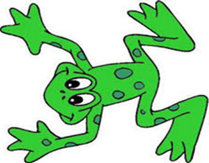

Mrs Napier’s
P3 Read Write Inc Group
Using phonics to read and write new words.

Slide 2
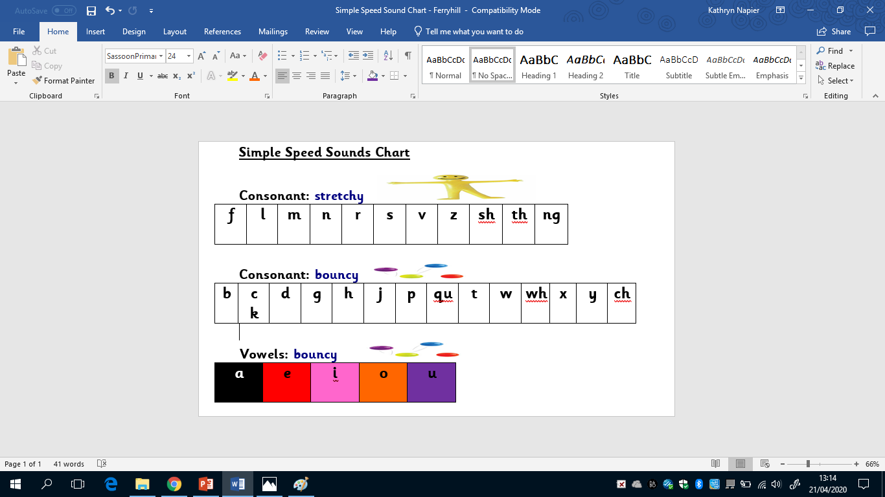
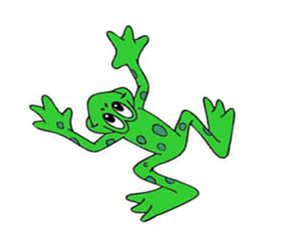

Just like we do at school we are going to practise our sounds.
Don’t forget to make the sounds stretchy or bouncy!

Slide 3

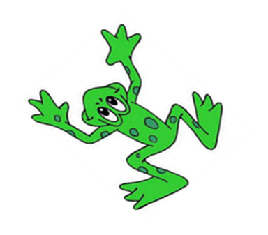
Were you able to remember all your sounds?
Try and practise every day.

Slide 4
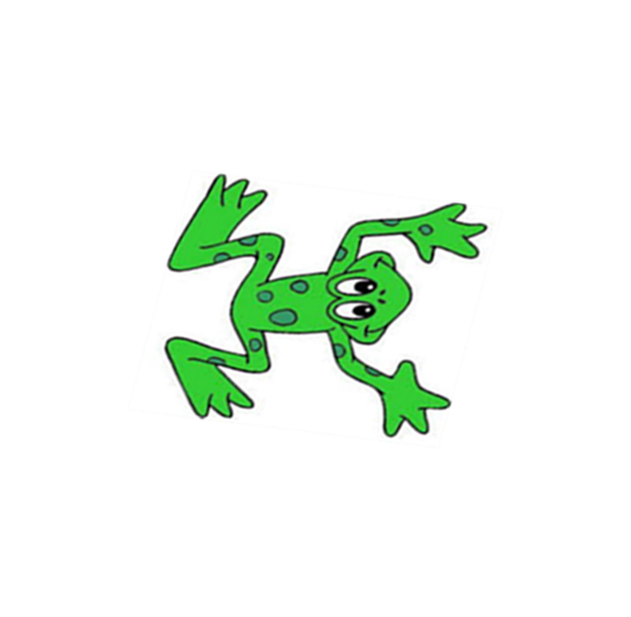
Next we are going to practise our green words.

Slide 5
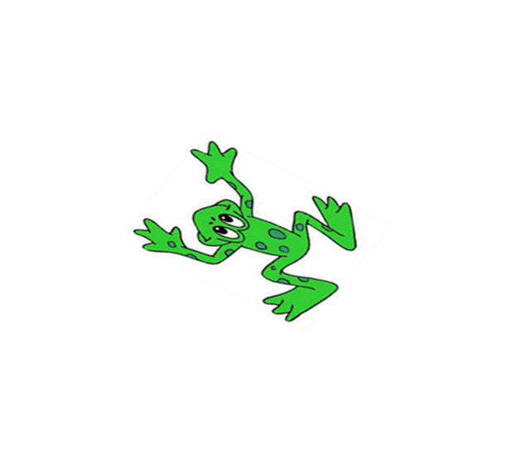
h
a
d

Slide 6
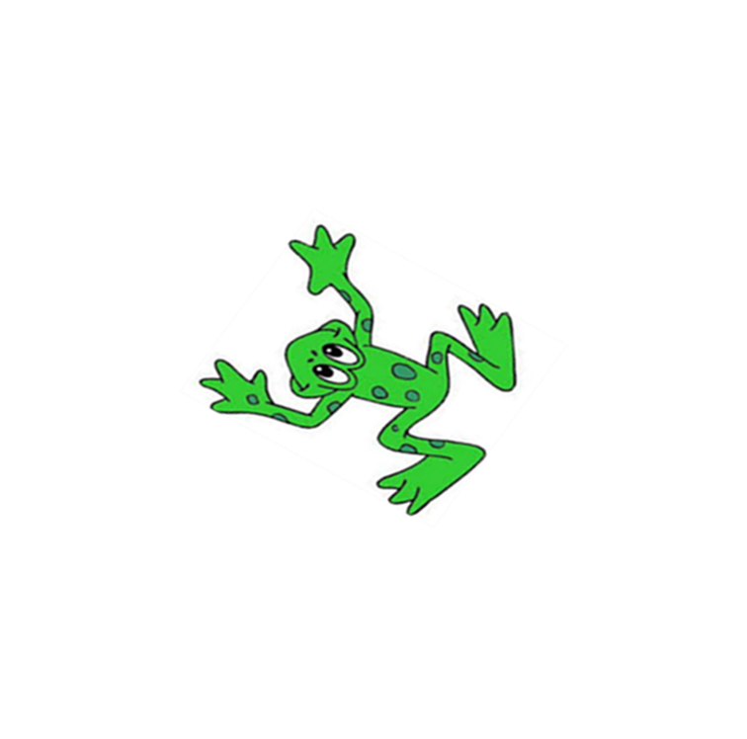
s
a
t

Slide 7
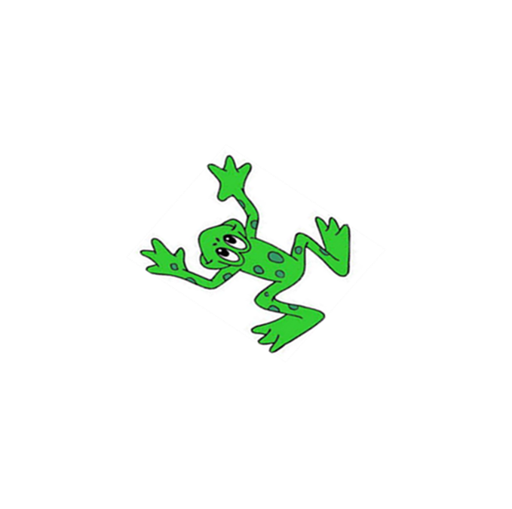
f
u
n

Slide 8

a
n
d

Slide 9

r
u
n

Slide 10
th
i
s

Slide 11
b
a
ng

Slide 12
s
i
ng

Slide 13

s
p
l
o
sh

Slide 14
This weeks red words are…
put
the

Slide 15

Well done if you have got this far!
Next we are going to look at our books.
A note for your grown up:
Next we are going to read our books. You will have to register to use the Oxford Owl eBooks. It is not difficult and we will be using them every week.
There are three stories in each book, you do not need to read all of the stories every day.

Slide 16

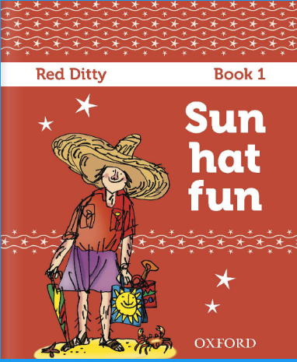


Slide 17

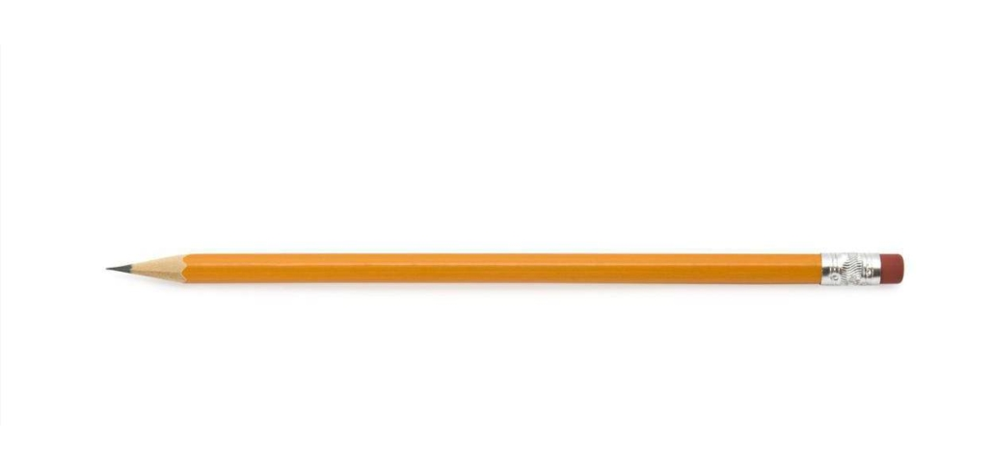


Hold a sentence.
You will need:
a pencil and paper
What do we need to remember so we know we have done well?
I can read it.
A
capital letter at the start.
Full stop at the end
put the red word spelt correctly

Slide 18
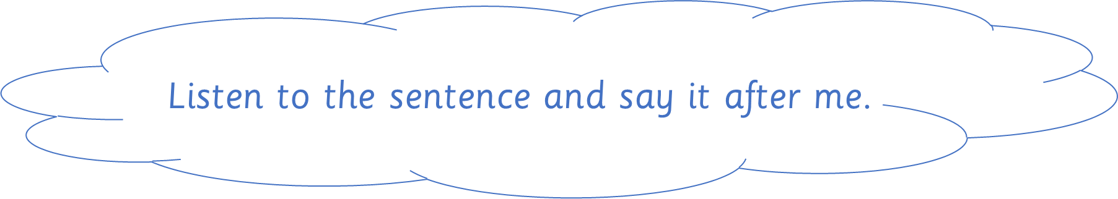



Slide 19




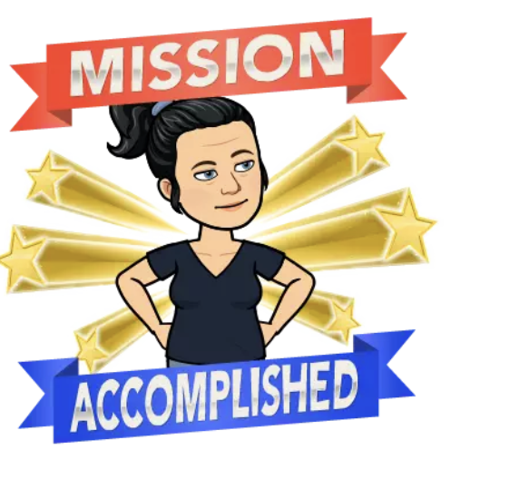
Mum
put
the
bun
in
the
bag.
M
Can you read your sentence?
Do you have a finger space?
Did you spell put and the correctly?
Do you have a capital letter at the start and a full stop at the end?

Slide 20

That’s all for now folks!

